Slide 1
Contoso, Ltd.
Fictitious Example
Discovery – Discovery Summary

Slide 2
Approach
All Up Summary
Systems, Servers, Databases, Web Applications, & Roles and Features
Azure Summary
Customer Catalog Overview
Key Concepts
Legacy Summary

Slide 3
Key Concepts

Slide 4
Key Concepts
Business Systems
A high-level business System that contains one or more Servers, and their associated Applications and Services
Servers and Applications can belong to more than one System
Migrations and Modernizations are primarily planned and executed at Business System level
Servers
Listing of Servers discovered
Information collected for a Server includes Operating System, Hardware and Applications
Can include Windows, Linux and UNIX servers
Legacy Windows Server
Windows Server computer version 2000, 2003, or 2003 R2
Additionally, Windows Server 2008 when the target is Microsoft Azure
Modern Windows Server
Windows Server 2008 R2, 2012, or 2012 R2 hosted on-premises or in Azure Infrastructure as a Service (IaaS)
Additionally, Windows Server 2008 when the target is hosted on-premises

Slide 5
Key Concepts (cont.)
Application Instances / Package
Listing of unique Applications listed in ARP (Add/Remove Programs) to one decimal point (i.e. major version and minor version)
Each known Application is automatically categorized before import
Each known Application is automatically set as Noise or Non-Noise before import
Can also contain information such as compatibility, supportability and modernization path
Examples of Applications include applications themselves, drivers, software updates, and supporting software
Server Applications
List of MSI Applications discovered on Windows Servers
List of Linux Applications
Noise / Non-Noise
Filters relevant application instances from supporting applications
Noise may include drivers, software updates, supporting components and administrative tools
Can be applied to both Application Instances and Windows Server Roles

Slide 6
Modernization Workstreams
Application Modernization
Data Platform Modernization
Infrastructure Modernization
Modernization of custom applications to Microsoft Azure PaaS
Remediation of complex custom applications
Modernization of the SQL Server data platform
Migration from Oracle to SQL Server
Server Migration
Workload Migration *
Migration of Windows and Linux servers
Migration and/or remediation of applications, data, databases and server roles to a modern server version
Per Business System
Per DB / SSIS
Per Server
Per Server
Custom Applications
Database Platforms
Windows and Linux Servers
Windows Workloads
* Includes simple remediation and reconfiguration of custom applications and databases

Slide 7
Potential Cloud Targets
New IT reality
Implementation
Service Model
Hybrid cloud
Public cloud
off-premises
SaaS
(Microsoft Dynamics Online, Office 365, etc)
Commodity
Application Modernization
PaaS
(Windows Azure Database, Web, Worker, etc)
IaaS
(Windows Azure Virtual Machines)
Infrastructure Modernization
Cost and Savings
Private cloud
on-premises
Optimized workloads for Private IaaS VMs
Workloads
Notes:
It outlines what applications and capabilities will potentially migrate to the various cloud services:
Commoditized services, such as Microsoft Dynamics 365, SharePoint, and email, should ideally be through SaaS.
New development of applications and migration of certain strategic custom application should ideally use the Windows Azure PaaS.
Remining applications can potentially be migrated to the Windows Azure IaaS, where possible.
Some application may remain on-premises (for example applications that will be retired in the new future, or workloads not suitable / supported on Microsoft Azure.

Slide 8
Server and Application Summary

Slide 9
5175
TOTAL applications
(across all servers)
878
UNIQUE applications
793 / 74 / 11 / 0
MICROSOFT / THIRD-PARTY / CUSTOM / UNKNOWN
application category ratio
Servers and Applications
281 / 14 / 4
299
645 / 233
SERVERS total
WINDOWS / LINUX / OTHER
YES / NO
operating system ratio
application noise ratio
Notes:
Description: This is a summary of all information discovered
Source: DCP Tool – Dashboard View

Slide 10
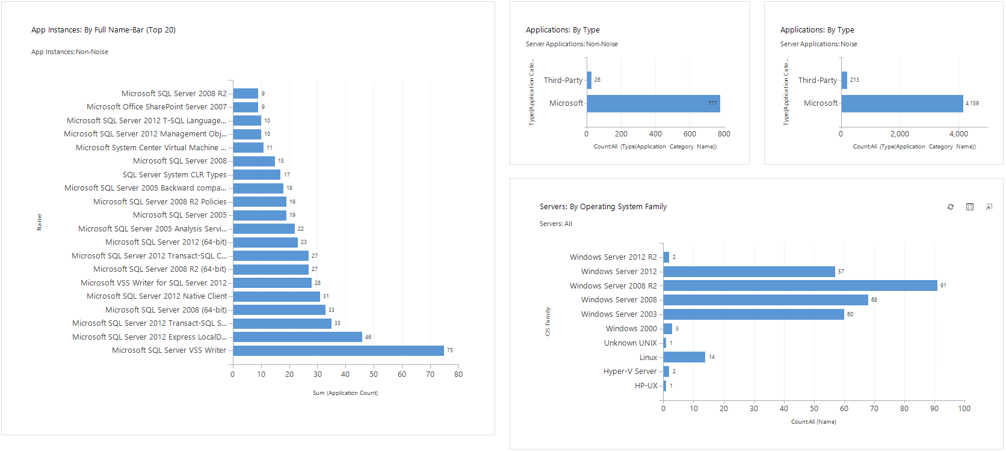
All Up Summary
Notes:
Description: This is a summary of all information discovered.
Source: Customer Catalog Dashboard – “0.0 Summary: All Up”

Slide 11
Cloud Assessment Summary

Slide 12
Potential Cloud Targets
New IT reality
Implementation
Service Model
Hybrid cloud
Public cloud
off-premises
SaaS
(Microsoft Dynamics Online, Office 365, etc)
16 applications
20 Application Instances
PaaS
(Windows Azure Database, Web, Worker, etc)
IaaS
(Windows Azure Virtual Machines)
268 Servers
Cost and Savings
Private cloud
on-premises
Optimized workloads for Private IaaS VMs
TBD
Notes:
It outlines what applications and capabilities will potentially migrate to the various cloud services:
Commoditized services, such as Microsoft Dynamics 365, SharePoint, and email, should ideally be through SaaS.
New development of applications and migration of certain strategic custom application should ideally use the Windows Azure PaaS.
Remining applications can potentially be migrated to the Windows Azure IaaS, where possible.
Some application may remain on-premises (for example applications that will be retired in the new future, or workloads not suitable / supported on Microsoft Azure.

Slide 13
Business Systems

Slide 14
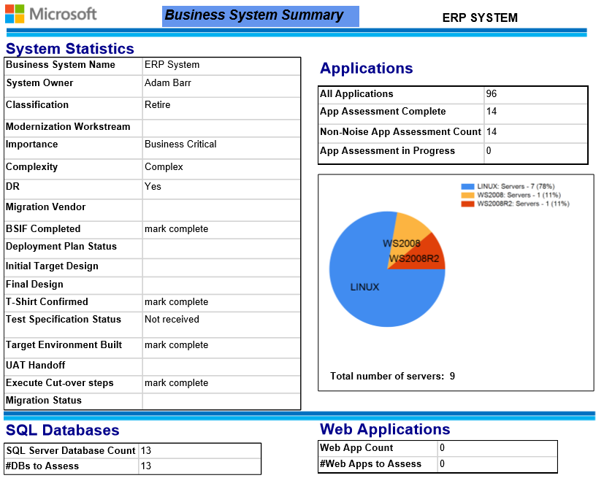
Notes:
Description: This is a summary of Business System information provided by the customer.
Source: System entity – “3.6 System Summary Report” report

Slide 15
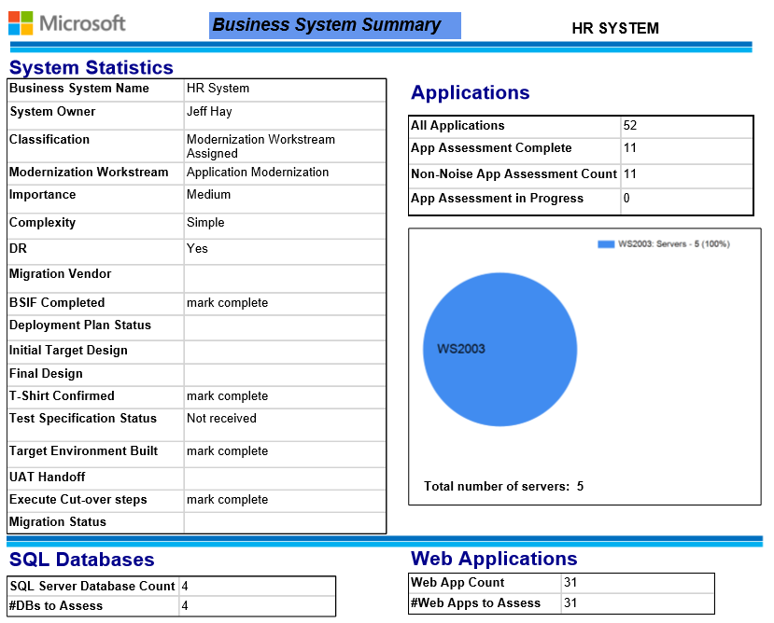
Notes:
Description: This is a summary of Business System information provided by the customer.
Source: System entity – “3.6 System Summary Report” report

Slide 16
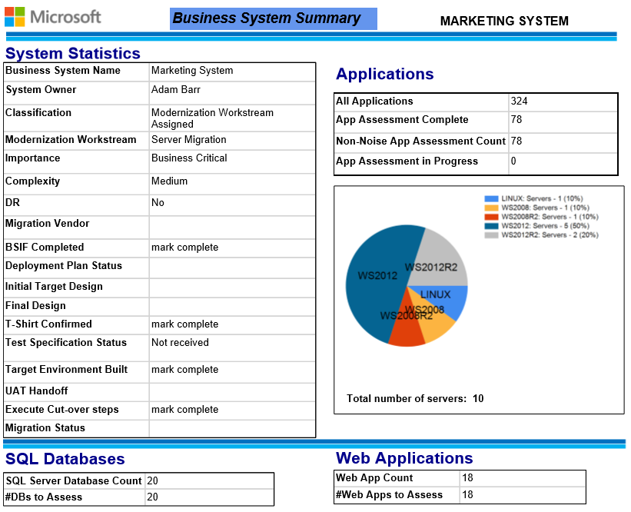
Notes:
Description: This is a summary of Business System information provided by the customer.
Source: System entity – “3.6 System Summary Report” report

Slide 17
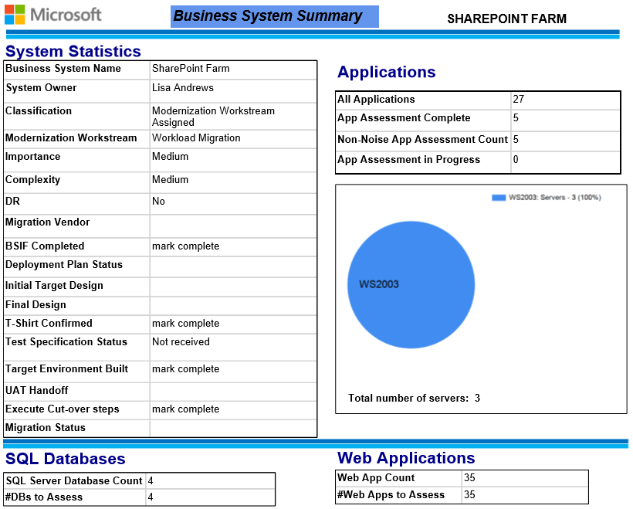
Notes:
Description: This is a summary of Business System information provided by the customer.
Source: System entity – “3.6 System Summary Report” report

Slide 18
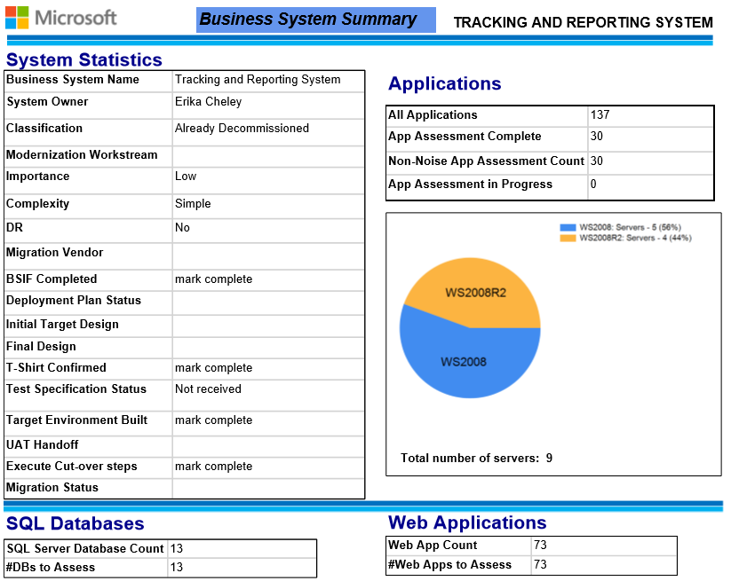
Notes:
Description: This is a summary of Business System information provided by the customer.
Source: System entity – “3.6 System Summary Report” report

Slide 19
Servers

Slide 20
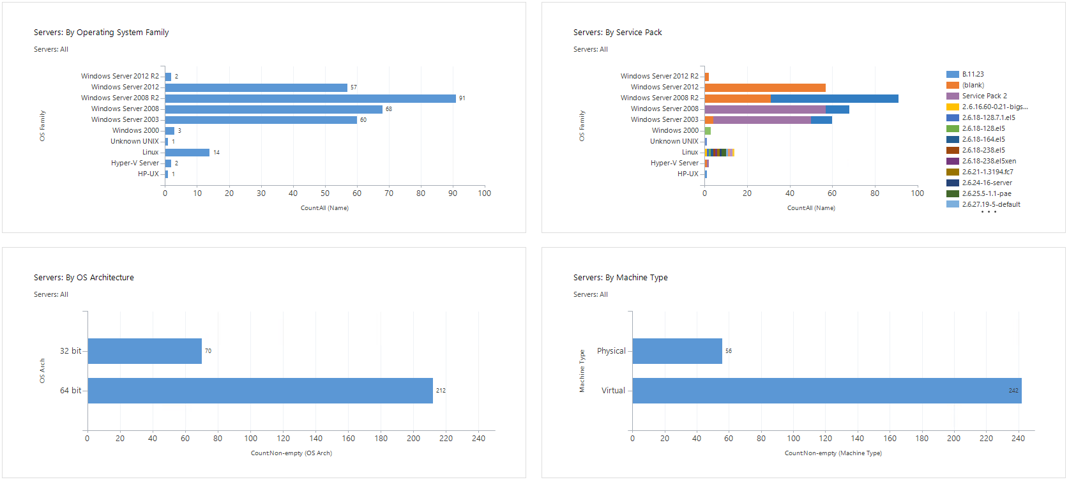
Servers
Notes:
Description: This is a summary of Server information discovered.
Source: Customer Catalog Dashboard – “1.2 Discover: All Servers”

Slide 21
Applications

Slide 22
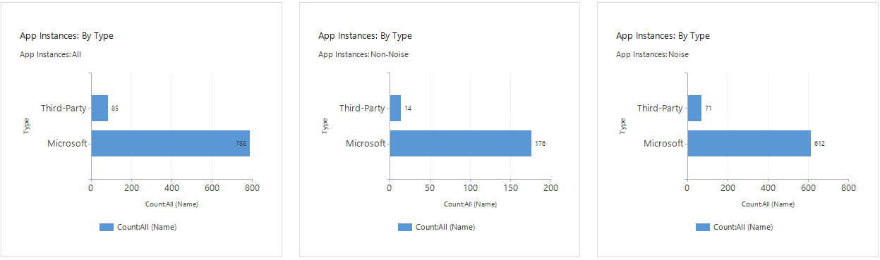
Application Instances (By Type)
Notes:
Description: This is a summary of all unique MSI application instances discovered, by Type.
Source: Customer Catalog Dashboard – “1.3 Discover: Application Instances (By Type)”

Slide 23
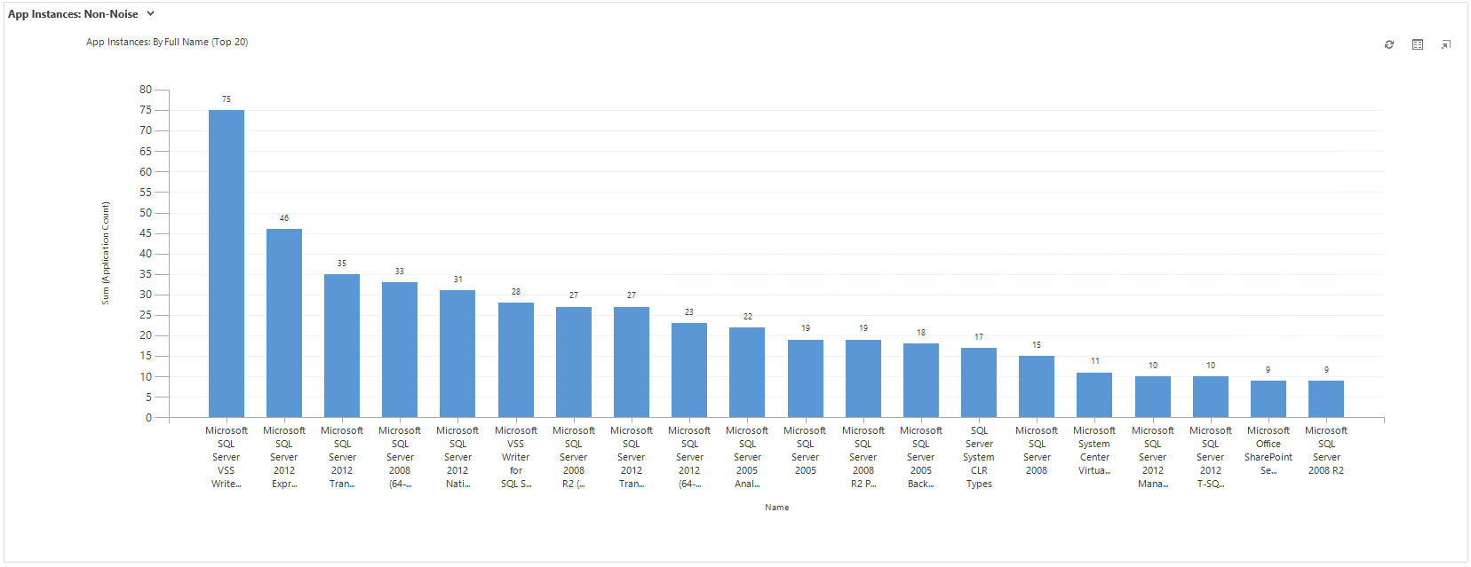
Application Instances (Top 20 Non-Noise)
Notes:
Description: This is list of the top 20 non-noise, unique MSI application instances discovered.
Source: Customer Catalog Dashboard – “1.3 Discover: Application Instances (Top 20)”

Slide 24
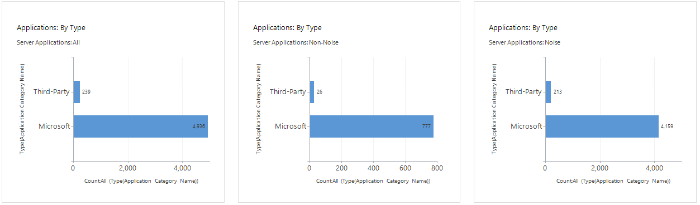
Server Applications (By Type)
Notes:
Description: This is a summary of all applications discovered across all servers, by Type.
Source: Customer Catalog Dashboard – “1.3 Discover: Server Applications (By Type)”

Slide 25
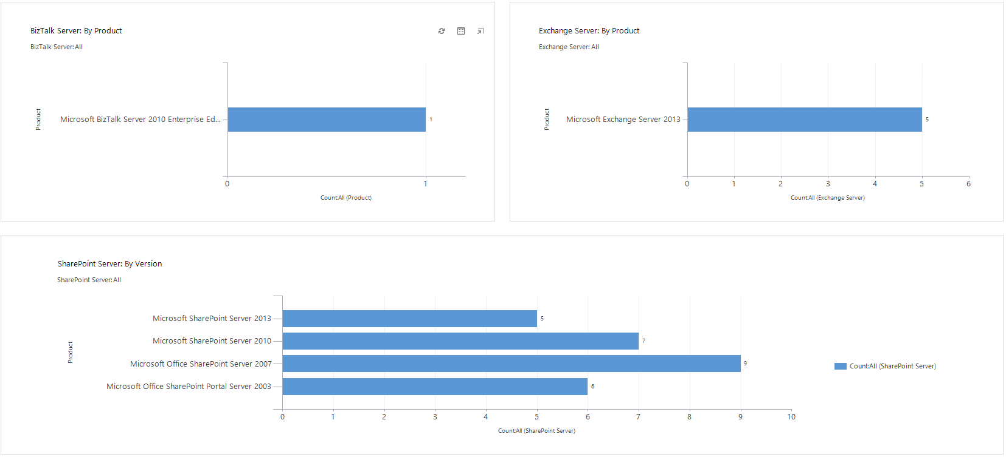
Microsoft Applications (BizTalk, Exchange, SharePoint)
Notes:
Description: This is a summary of certain Microsoft applications discovered.
Source: Customer Catalog Dashboard – “1.3 Discover: Microsoft Applications”

Slide 26
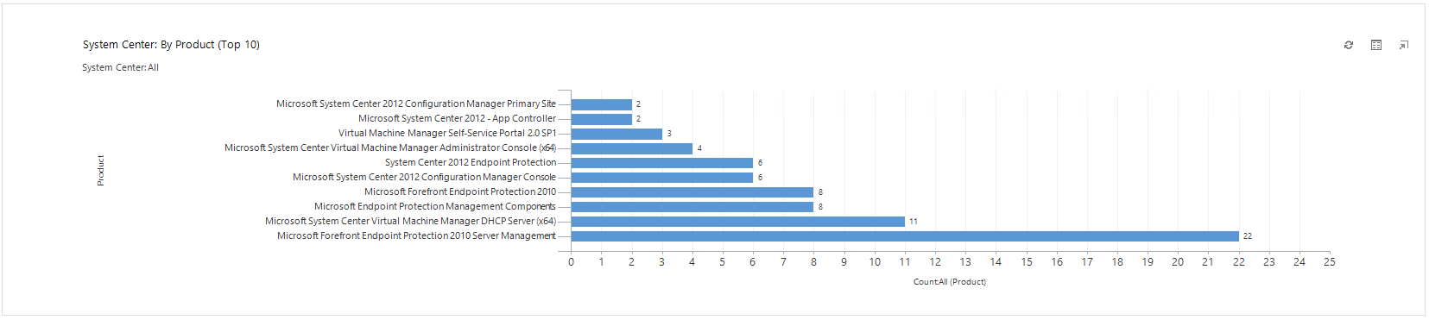
Microsoft Applications (System Center)
Notes:
Description: This is a summary of certain Microsoft applications discovered.
Source: Customer Catalog Dashboard – “1.3 Discover: Microsoft Applications”

Slide 27
Databases

Slide 28
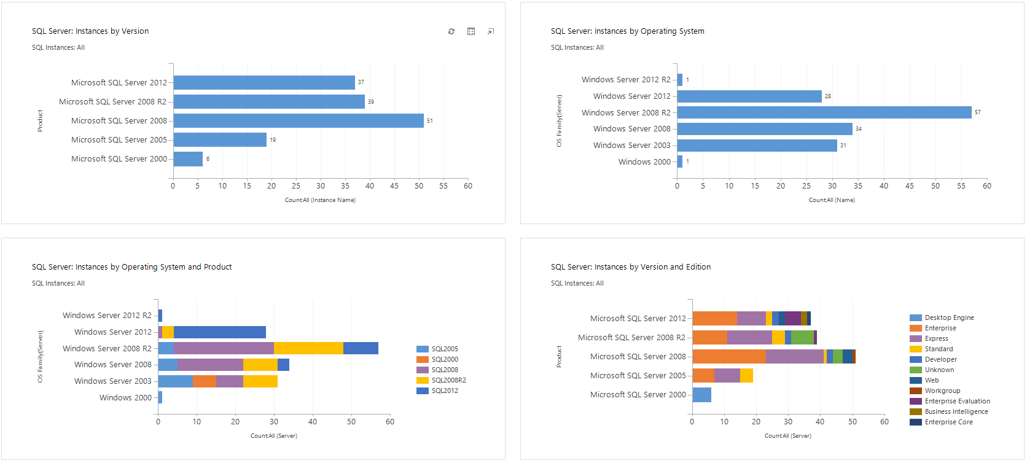
SQL Server Instances
Notes:
Description: This is a summary of all SQL Server Instances discovered.
Source: Customer Catalog Dashboard – “1.4 Discover: SQL Server Instances”

Slide 29
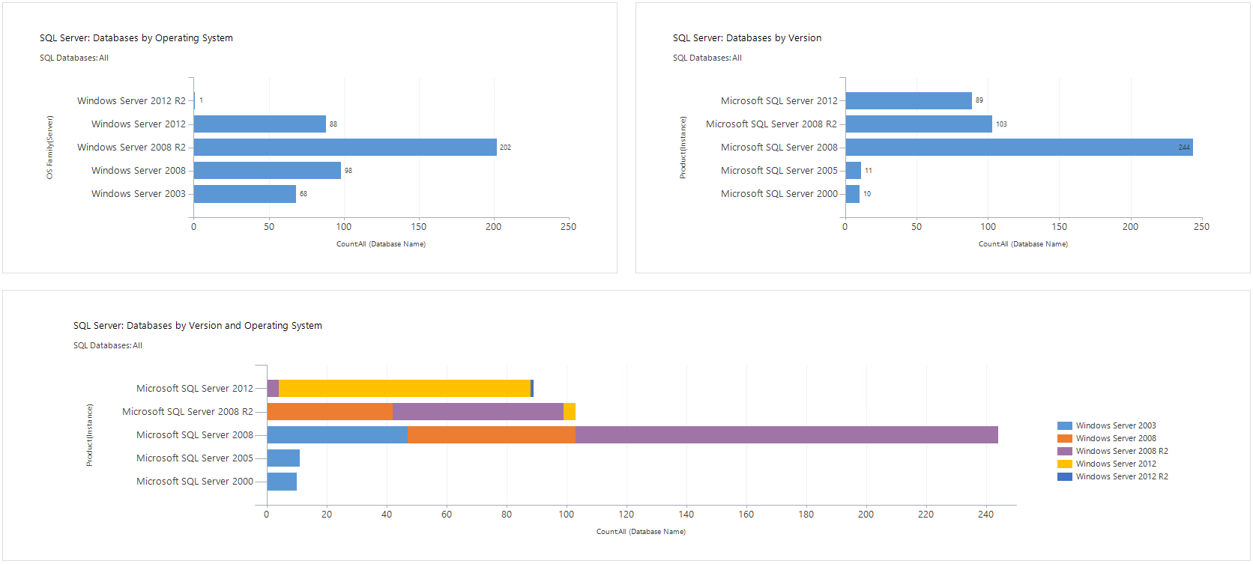
SQL Server Databases
Notes:
Description: This is a summary of all SQL Server Databases discovered.
Source: Customer Catalog Dashboard – “1.4 Discover: SQL Databases”

Slide 30
Web Applications

Slide 31
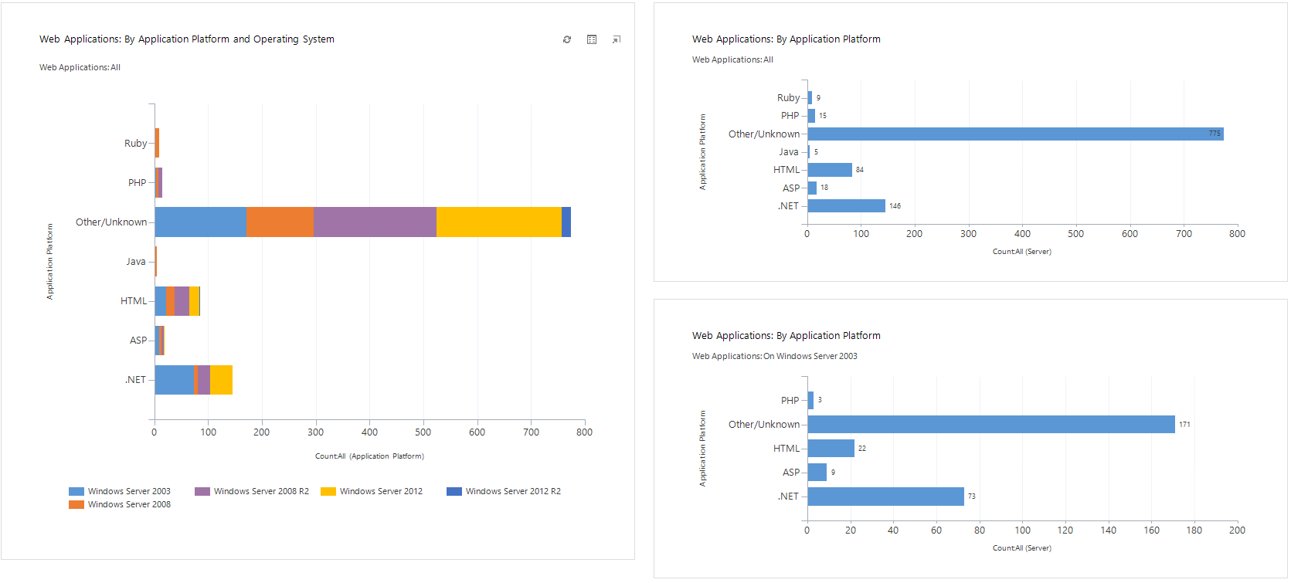
Web Applications
Notes:
Description: This is a summary of Web Applications discovered, by Application Platform.
Source: Customer Catalog Dashboard – “1.5 Discover: Web Applications”

Slide 32
Roles and Features

Slide 33
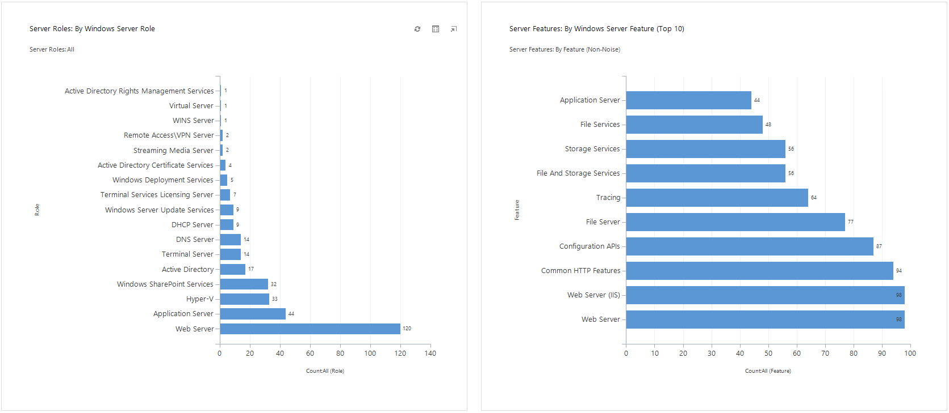
Roles and Features
Notes:
Description: This is a summary of server information discovered.
Source: Customer Catalog Dashboard – “1.6 Discovery: Roles and Features”

Slide 34
Active Directory - Sites
Notes:
Description: This is a summary of Active Directory Sites discovered.
Source: Microsoft Active Directory Topology Diagrammer (http://www.microsoft.com/en-us/download/details.aspx?id=13380).

Slide 35
Active Directory - Domains
Notes:
Description: This is a summary of Active Directory Domains discovered.
Source: Microsoft Active Directory Topology Diagrammer (http://www.microsoft.com/en-us/download/details.aspx?id=13380).

Slide 36
Azure Summary

Slide 37
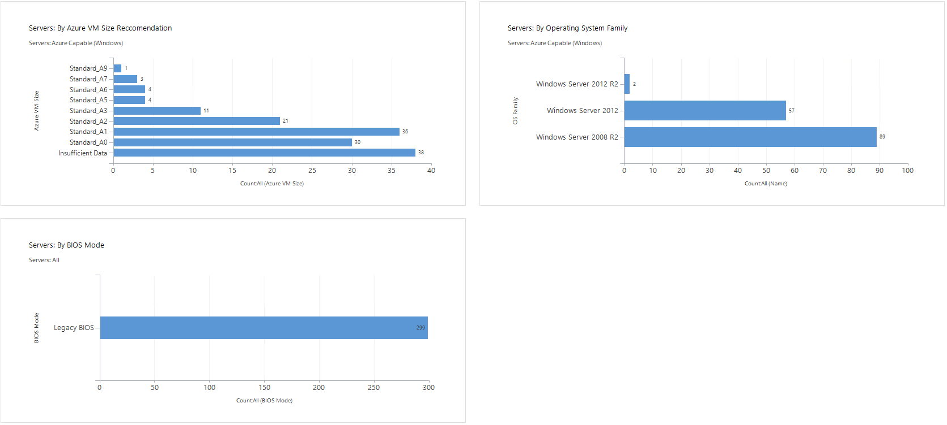
Azure
Disclaimer: The discovery information as a result of this engagement, that is presented in this slide, and the Azure-related information that can be found in the Customer Catalog is provide merely for initial planning purposes only. This is not an in-depth assessment for specific suitability for migration to Microsoft Azure VMs. For example, while an Operating System may be Azure capable, some applications running on the server may not be supported on Azure.
Notes:
Description: This is a summary of pertinent information relating to potential migration to Azure VMs.
Source: Customer Catalog Dashboard – “1.2 Discover: Azure VM Summary”

Slide 38
Legacy Summary

Slide 39
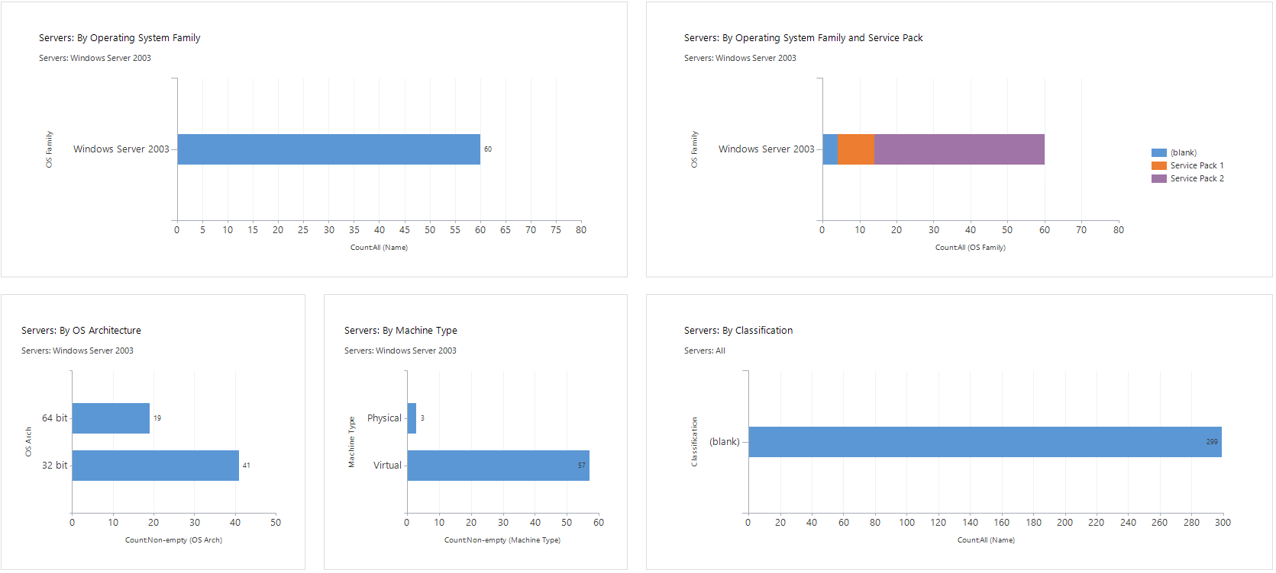
Windows Server 2003
Notes:
Description: This is a summary of Windows Server 2003 information discovered.
Source: Customer Catalog Dashboard – “1.2 Discover: Windows Server 2003”

Slide 40
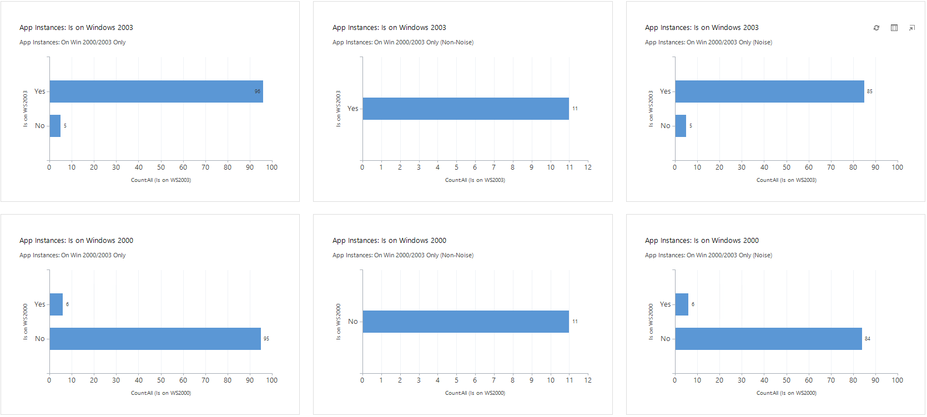
Applications on Windows 2000/2003
Notes:
Description: This is a summary of Windows Server 2003 information discovered.
Source: Customer Catalog Dashboard – “1.3 Discover: App on Win2000/2003”

Slide 41
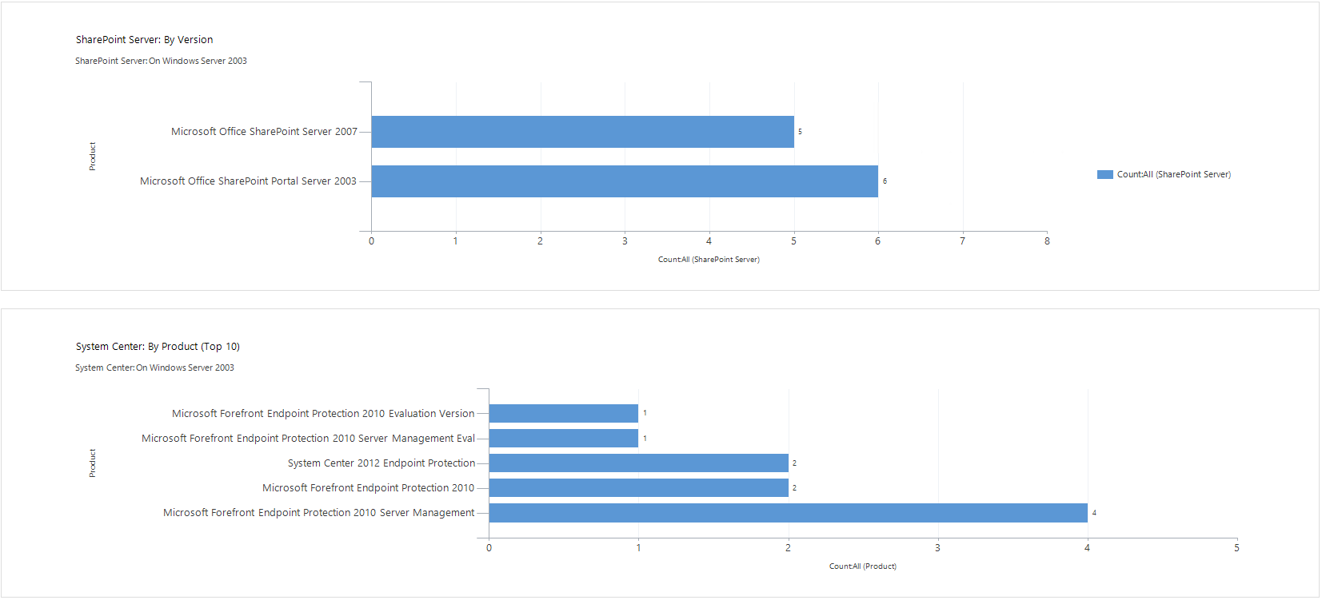
Microsoft Applications (SharePoint and System Center)
Notes:
Description: This is a summary of certain Microsoft applications discovered.
Source: Customer Catalog Dashboard – “1.3 Discover: Microsoft Applications”

Slide 42
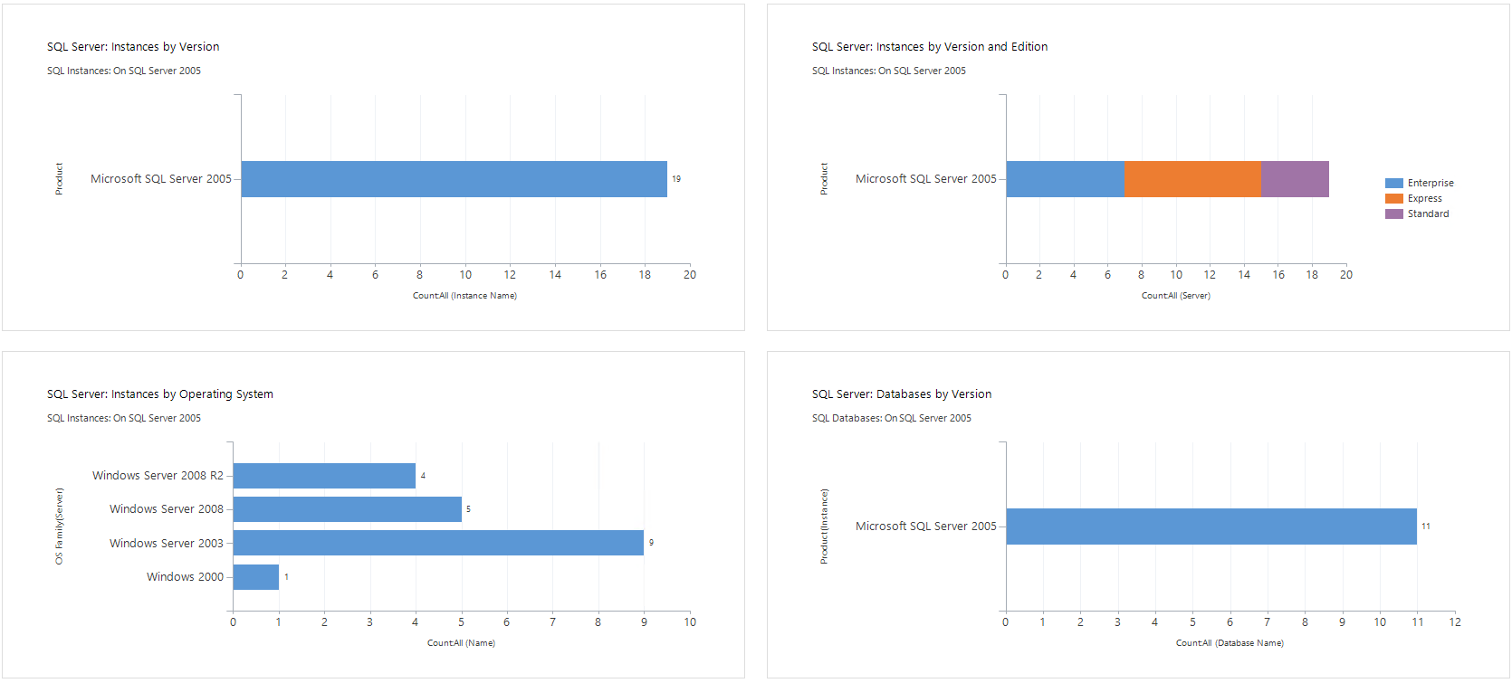
SQL Server 2005
Notes:
Description: This is a summary of SQL Server 2005 information discovered.
Source: Customer Catalog Dashboard – “1.4 Discover: SQL Server 2005”

Slide 43
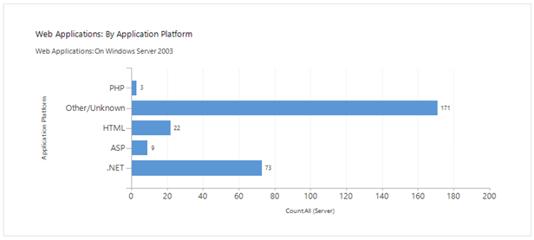
Web Applications on Windows Server 2003
Notes:
Description: This is a summary of Web Applications discovered on Windows Server 2003, by Application Platform.
Source: Customer Catalog Dashboard – “1.5 Discover: Web Applications”

Slide 44
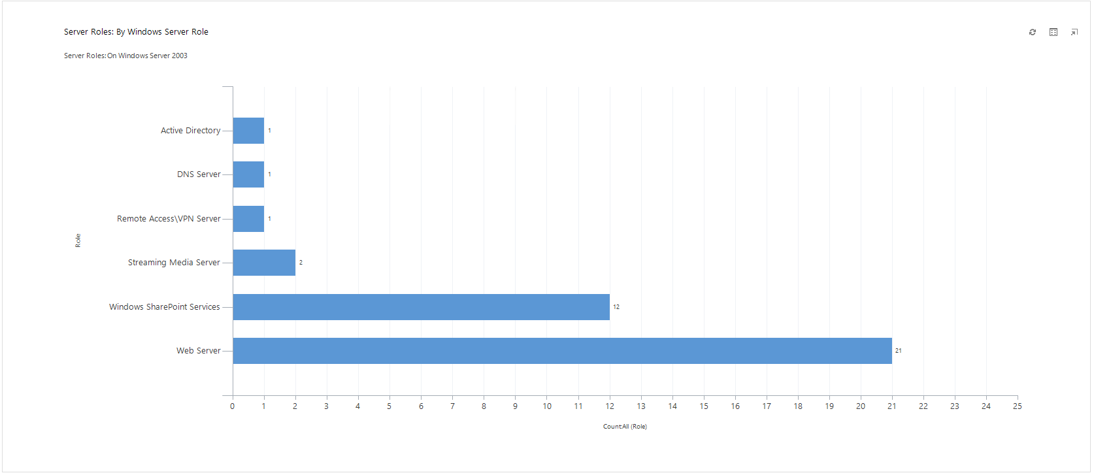
Windows Server 2003 Roles
Notes:
Description: This is a summary of SQL Server 2005 information discovered.
Source: Customer Catalog Dashboard – “1.6 Discover: Roles on Windows Server 2003”

Slide 45
Customer Catalog Overview

Slide 46
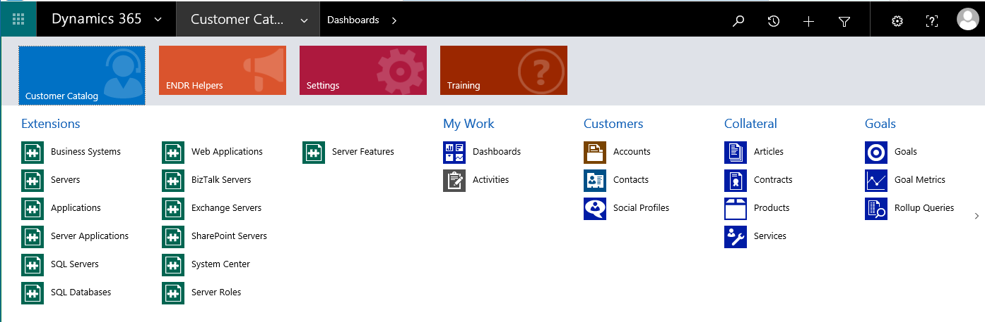
Walkthrough

Slide 47
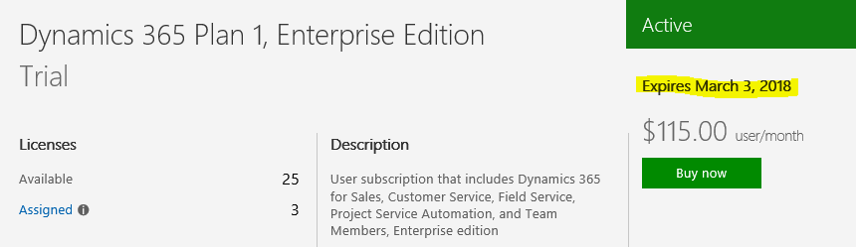
Handover
Handover Accounts
CRM Admin
Upload User
Confirm Unused Microsoft Accounts have been removed
Dynamics 365 Trial Expiry Date:
Example

Slide 48
Thank You!

Slide 49

© 2016 Microsoft Corporation. All rights reserved. Microsoft, Windows, and other product names are or may be registered trademarks and/or trademarks in the U.S. and/or other countries. The information herein is for informational purposes only and represents the current view of Microsoft Corporation as of the date of this presentation. Because Microsoft must respond to changing market conditions, it should not be interpreted to be a commitment on the part of Microsoft, and Microsoft cannot guarantee the accuracy of any information provided after the date of this presentation. MICROSOFT MAKES NO WARRANTIES, EXPRESS, IMPLIED OR STATUTORY, AS TO THE INFORMATION IN THIS PRESENTATION. Microsoft, Windows, Windows Server, Windows Server 2008 R2 are either registered trademarks or trademarks of Microsoft Corporation in the United States and/or other countries..

